Slide 1
BA03_Module 1_ Assignment 2 Introduction to Data Management
Pratik Chakraborty

Slide 2
Introduction to Data Management
Explore the Diabetes data set with the template and data pipeline as below: The submission must include the complete data flow and data pipe line diagrams, well commented codes, insights from exploration and derived rules for classification, should be submitted. Submission Guidelines Please create a GitHub profile and upload your code. Create a PPT with the process followed and insights and rules with link to the GitHub code before the next session. This is an individual assignment.
Read Dataset
Explore
Create Variables
X
Visualise
Univariate
Head
Tail
Describe
Y
Z
Histograms
Visulaise
Visualise
Bivariate
Scatterplot
Correlation matrix
3 Variables
Discover rules

Slide 3
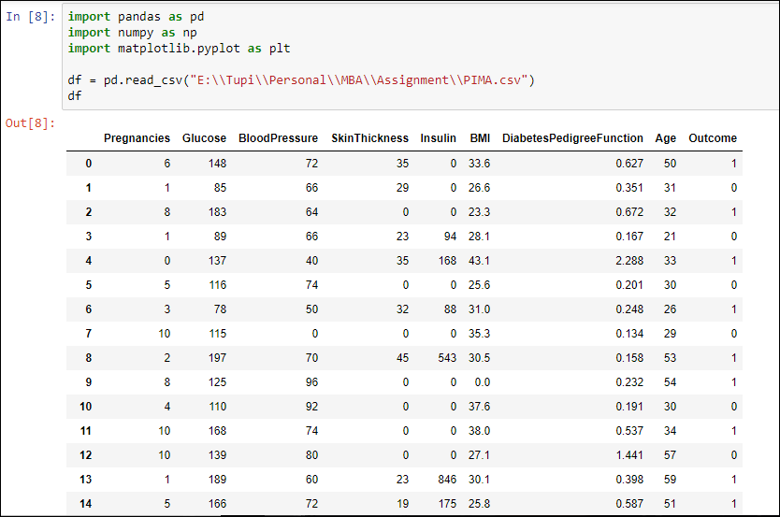
Read Dataset- df

Slide 4
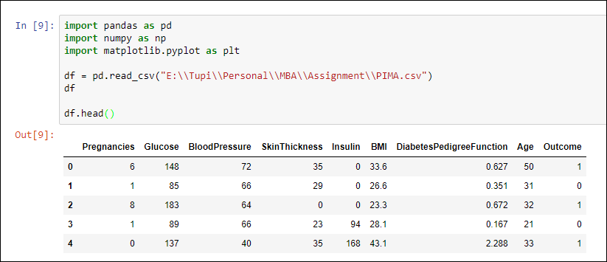
Read Dataset- Check Head()

Slide 5
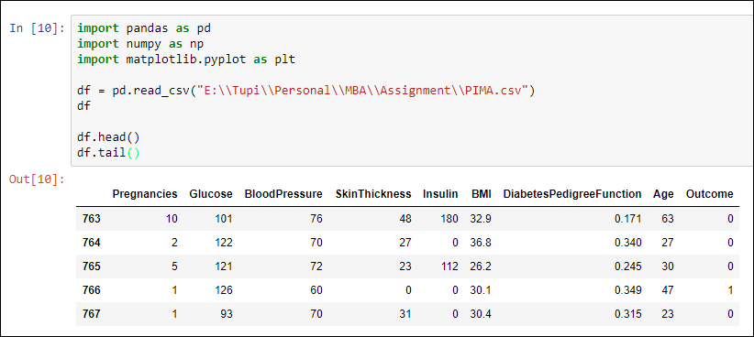
Read Dataset- Check Tail()

Slide 6
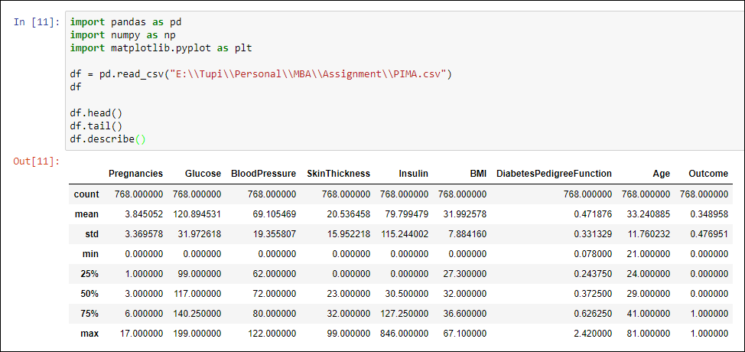
Read Dataset

Slide 7
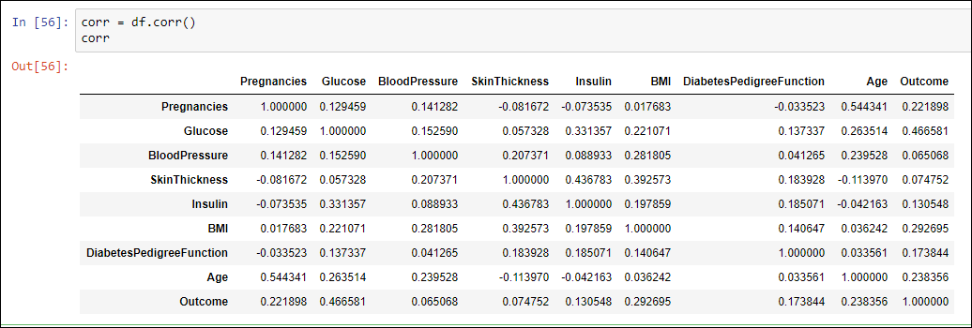
Correlational Matrix

Slide 8
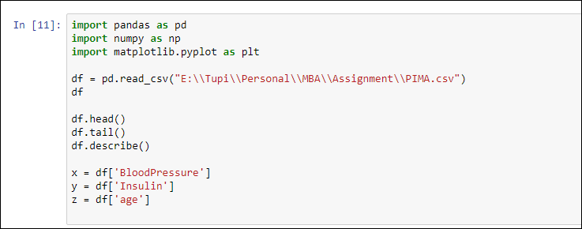
Create Variables

Slide 9
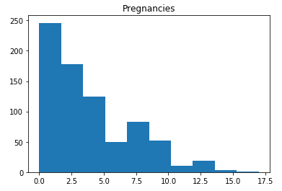
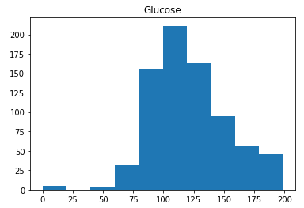
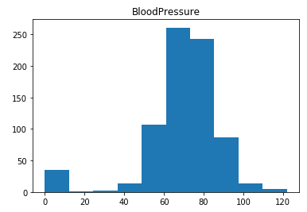
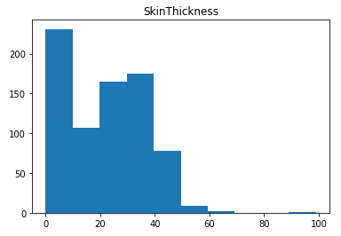
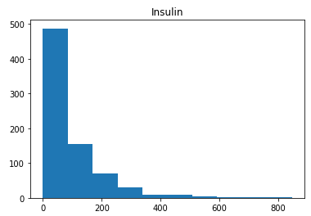
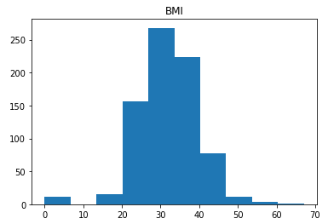
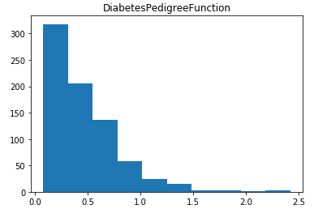
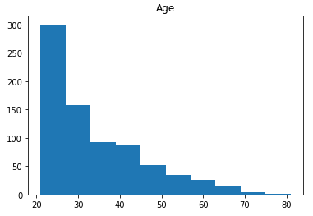

Slide 10
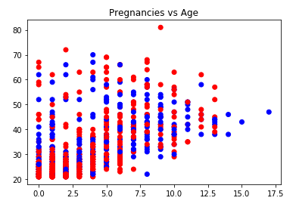
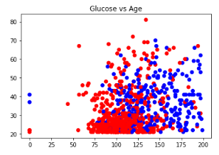
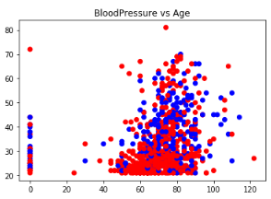
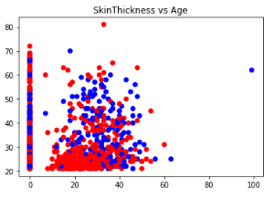
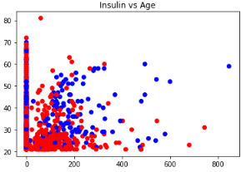
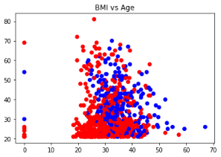
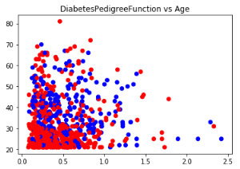

Slide 11
Rule
BMI range above 20 and diabetes range above 30 , very less chance of diabetes

Slide 12
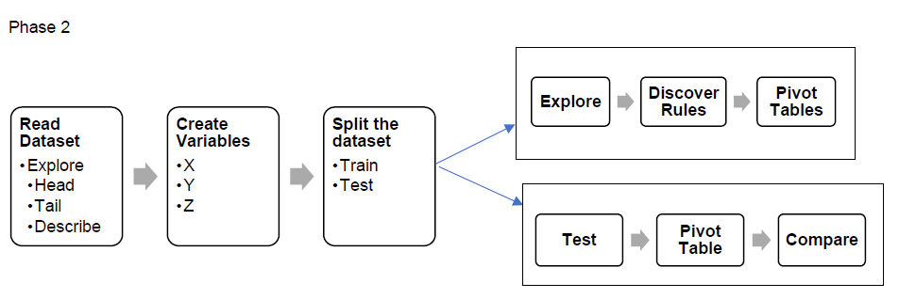
Assessment – 2_Phase – 2

Slide 13
Sampling

Slide 14
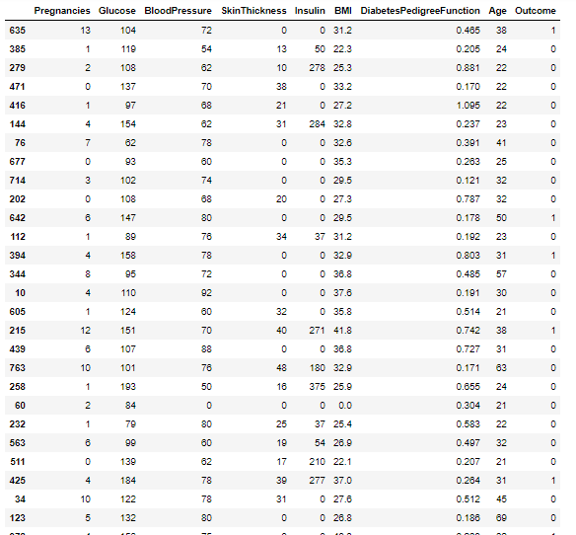
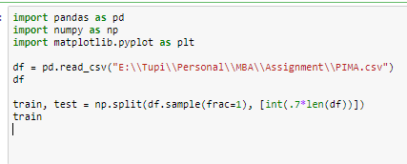
Sampling – Train (70%)

Slide 15
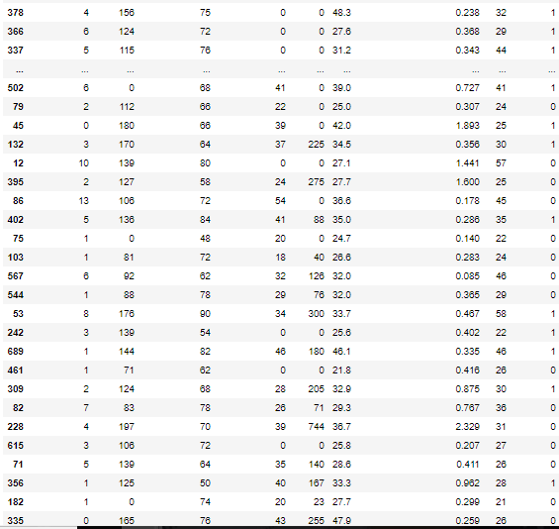
Sampling – Train (70%)

Slide 16
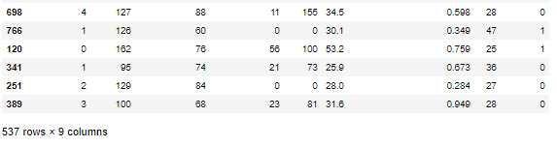
Sampling – Train (70%)

Slide 17
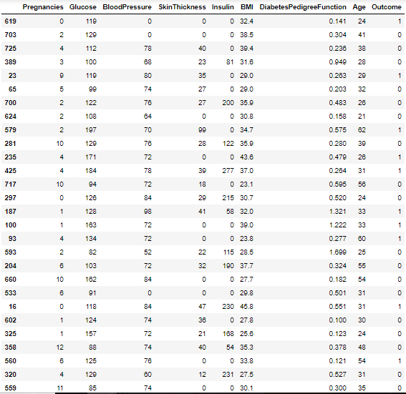

Sampling – Test (30%)

Slide 18
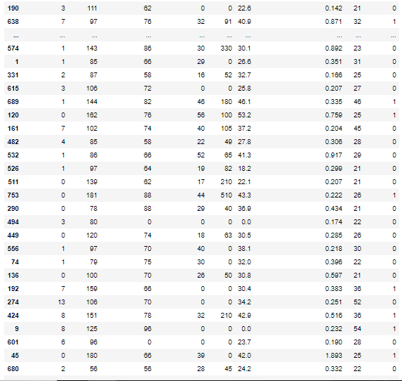
Sampling – Test (30%)

Slide 19
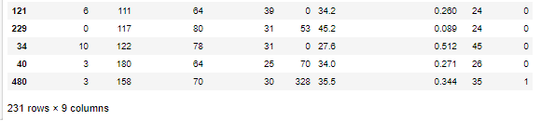
Sampling – Test (30%)

Slide 20


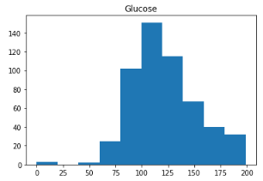

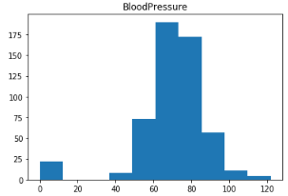
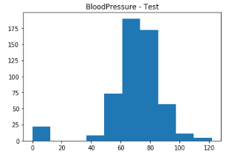
Train – Explore (Histograms)
Test – Explore (Histograms)

Slide 21
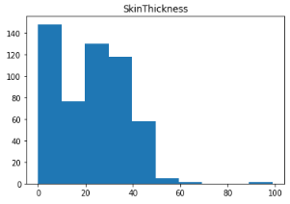

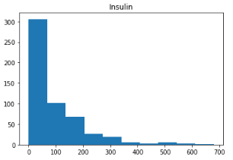
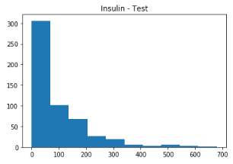
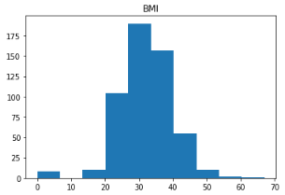
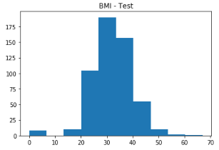
Train – Explore (Histograms)
Test – Explore (Histograms)

Slide 22

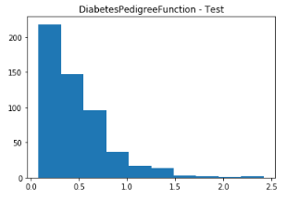
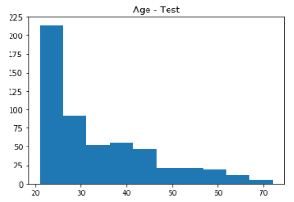
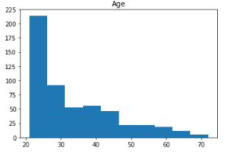
Train – Explore (Histograms)
Test – Explore (Histograms)

Slide 23
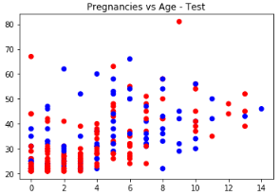
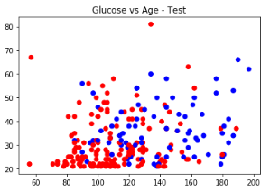
Train – Explore (Scatter Plots)
Test – Explore (Scatter Plots)

Slide 24
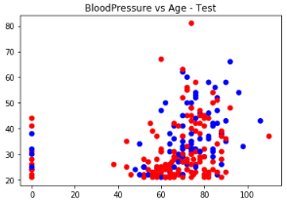
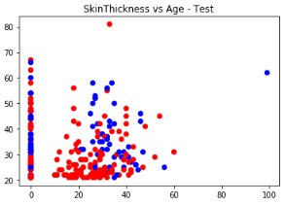
Train – Explore (Scatter Plots)
Test – Explore (Scatter Plots)

Slide 25
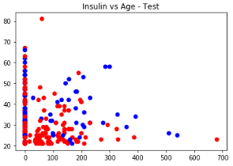
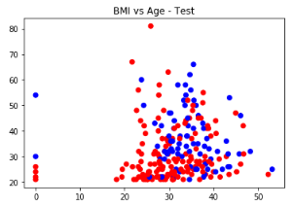
Train – Explore (Scatter Plots)
Test – Explore (Scatter Plots)

Slide 26
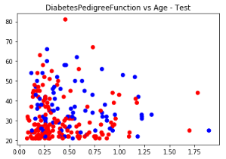
Train – Explore (Scatter Plots)
Test – Explore (Scatter Plots)

Slide 27
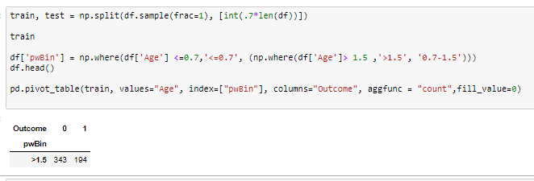
Train – PIVOT

Slide 28
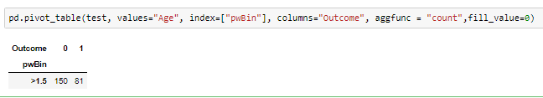
Test – PIVOT

Slide 29
Rule
BMI range above 30 and diabates range above 30 , very less chance of diabetes

Slide 30
Thank You

